Slide 1
Introduction to Object-Oriented Programming (OOP)

Slide 2
Programming paradigms
1. Procedural Programming
Code as a sequence of step-by-step instructions/procedures (functions) that operate on data. No bundling of data and behavior.
Examples: C, Pascal, early BASIC
Core idea: "Do this, then this, then this."
C
int add(int a, int b) {
return a + b;
}
2. Object-Oriented Programming (OOP)
Data and behavior are bundled into objects. (Covered in your last question — classes, inheritance, polymorphism, encapsulation.)
Examples: Java, C++, Python, Ruby
Core idea: "Objects that have state and behavior."

Slide 3
Programming paradigms
3. Functional Programming
Computation is treated as evaluating mathematical functions. Avoids changing state or mutable data — emphasizes pure functions, immutability, and functions as first-class values.
Examples: Haskell, Lisp, Erlang; Python/JS support functional style
Core idea: "Same input always gives same output. No side effects."
python
# Functional style in Python
add = lambda a, b: a + b
squares = list(map(lambda x: x**2, [1, 2, 3]))

Slide 4
Programming paradigms
4. Logical Programming
Programs are written as a set of facts and rules. You state what is true, and the system figures out how to satisfy queries against those rules (uses inference/search, not explicit steps).
Examples: Prolog, Datalog
Core idea: "Here are the facts and rules — you figure out the answer."
prolog
parent(tom, bob).
parent(bob, ann).
grandparent(X, Y) :- parent(X, Z), parent(Z, Y).
% Query: grandparent(tom, ann). → true

Slide 5
Programming paradigms
5. Declarative Programming (logical & functional)
A broader umbrella — you describe what you want, not how to get it. Functional and logical programming are both subsets of declarative programming. SQL is the classic example.
Examples: SQL, HTML, regex, Prolog
Core idea: "Describe the result, not the steps."
sql
SELECT name FROM employees WHERE department = 'Finance’;
6. Imperative Programming (procedural & OOP)
The opposite umbrella to declarative — you explicitly tell the computer how to do something, step by step. Procedural and OOP are both subsets of imperative programming.

Slide 6
Four core pillars of OOP
1. Classes and Objects
A class is a blueprint. An object is an instance created from that blueprint.
python
class Car:
def __init__(self, make, model):
self.make = make
self.model = model
my_car = Car("Toyota", "Corolla") # my_car is an object (instance) of Car

Slide 7
Four core pillars of OOP
2. Encapsulation
Bundling data (attributes) and behavior (methods) together, and controlling access to them.
python
class BankAccount:
def __init__(self, balance):
self._balance = balance # underscore = "internal use" convention
def deposit(self, amount):
self._balance += amount
def get_balance(self):
return self._balance
Python doesn't have true private variables — _balance is a convention, __balance triggers name-mangling, but nothing is truly locked. The point is controlling how data gets modified, not just hiding it.

Slide 8
Four core pillars of OOP
3. Inheritance
A class can inherit attributes/methods from another class, avoiding duplicate code.
python
class Vehicle:
def __init__(self, wheels):
self.wheels = wheels
def describe(self):
return f"This vehicle has {self.wheels} wheels."
class Motorcycle(Vehicle):
def __init__(self):
super().__init__(wheels=2) # calls parent's __init__
m = Motorcycle()
print(m.describe()) # "This vehicle has 2 wheels."
Motorcycle is the child/subclass, Vehicle is the parent/superclass.

Slide 9
Four core pillars of OOP
4. Polymorphism
Different classes can be used through the same interface, each responding differently to the same method call.
python
class Dog:
def speak(self):
return "Woof"
class Cat:
def speak(self):
return "Meow"
for animal in [Dog(), Cat()]:
print(animal.speak()) # Woof, then Meow
Same method name (speak), different behavior depending on the object's class.

Slide 10
Four pillars of OOP
Abstraction
Hiding complex implementation details behind a simple interface. In Python this is often done with abstract base classes:
python
from abc import ABC, abstractmethod
class Shape(ABC):
@abstractmethod
def area(self):
pass
class Square(Shape):
def __init__(self, side):
self.side = side
def area(self):
return self.side ** 2
Shape can't be instantiated directly — it forces any subclass to implement area().

Slide 11
Classes and objects in Python

Slide 12
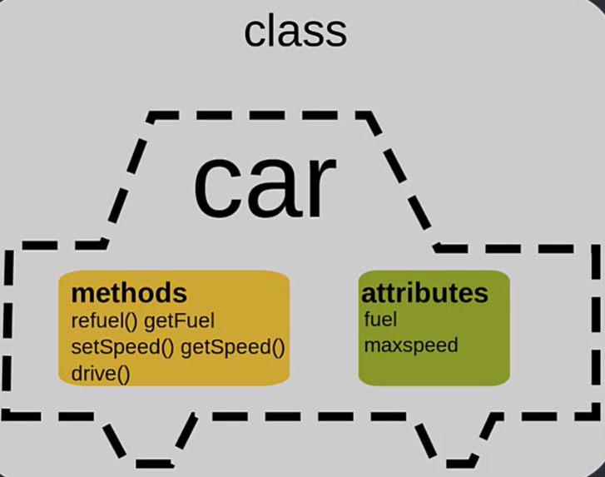
Class
A class is a blueprint or template
It describes what something should look like, but isn't the real thing itself
What a class contains:
Attributes — the data/info it will hold (like name, age, color)
Methods — the actions it can do (like bark, drive, save)
Simple example:
A Dog class might say: "every dog has a name and a breed, and every dog can bark"
That's it — the class is just the definition, nothing is created yet
Why we write classes:
So we don't repeat the same structure over and over
One class = one reusable definition for many future things

Slide 13
Class example
python
class Dog: # Has to be a capital letter
def __init__(self, name, breed):
self.name = name # Attributes
self.breed = breed
def bark(self): # Action
return f"{self.name} says Woof!"
Let's break down what's happening line by line:
class Dog: — this starts the class definition. Dog is the name of our blueprint.
def __init__(self, name, breed): — this is a special method that sets up the initial data whenever the blueprint gets used. name and breed are the attributes this class will hold.
self.name = name and self.breed = breed — these lines store the given name and breed as part of the class's structure.
def bark(self): — this defines a method, an action the class can perform.
return f"{self.name} says Woof!" — this is what happens when bark() is called.
Notes:
That's the whole class: it defines two attributes (name, breed) and one method (bark). Nothing has been created or run yet, this is purely the definition.

Slide 14
Class example
Now you can create actual dog objects from this class:
python
my_dog = Dog("Rex", "Labrador")
your_dog = Dog("Bella", "Poodle")
print(my_dog.bark()) # Rex says Woof!
print(your_dog.bark()) # Bella says Woof!

Slide 15
Class example
Line 1: my_dog = Dog("Rex", "Labrador")
This creates a real dog using the Dog blueprint
"Rex" becomes the name, "Labrador" becomes the breed
This real dog is stored in a variable called my_dog
Line 2: your_dog = Dog("Bella", "Poodle")
Same thing, but a separate dog
"Bella" is the name, "Poodle" is the breed
Stored in a different variable, your_dog
This dog is completely separate from my_dog — they don't share data
Line 3: print(my_dog.bark())
This calls the bark() method on my_dog
It runs the method using my_dog's own name, so it returns "Rex says Woof!"
print() then displays that text
Line 4: print(your_dog.bark())
Same idea, but using your_dog's info
Returns "Bella says Woof!"
The big idea:
One class (Dog) was used to create two separate real dogs
Each one keeps its own name and breed, even though they came from the same blueprint

Slide 16
Objects
An object is a real thing created from a class
The class is the blueprint; the object is the actual built thing
Creating an object from a class is called "instantiation" — you're making an "instance" of that class
Going back to our Dog class:
python
class Dog:
def __init__(self, name, breed):
self.name = name
self.breed = breed
def bark(self):
return f"{self.name} says Woof!"
This is still just the blueprint. No dog exists yet.

Slide 17
Objects
Now we create objects:
python
my_dog = Dog("Rex", "Labrador")
your_dog = Dog("Bella", "Poodle")
Dog("Rex", "Labrador") builds a real dog using the blueprint
That real dog gets stored in the variable my_dog
your_dog is a second, separate real dog, built from the same blueprint
Key idea — objects are independent:
my_dog and your_dog both came from Dog, but they don't share data
my_dog.name is "Rex", your_dog.name is "Bella" — changing one never touches the other
Each object has its own copy of the attributes defined by the class

Slide 18
Objects
Calling a method on an object:
python
print(my_dog.bark()) # Rex says Woof!
print(your_dog.bark()) # Bella says Woof!
.bark() uses whatever data that specific object holds
So my_dog.bark() uses Rex's name, your_dog.bark() uses Bella's name
Simple mental note:
Class = the plan (one)
Object = a real thing built from the plan (can be many, each separate)

Slide 19
Understanding init() Method and ‘self’ Parameter

Slide 28
Solving Task: OOPS

Slide 34
Defining Multiple constructors in Python

